Slide 1
Div : C5
Name | Roll No | Enrollment No
Kaladiya Darshan | 31 | 230801286
Ailani Piyush | 47 | 230801481

Slide 2
Unit-I: Introduction to Web Services

Slide 3
1.
What is Web Service?
2.
Type of Web Service
3.
Web Services Advantages
4.
Web Service Architecture
5.
Web Service Characteristics

Slide 4
What is a Web Service?
Definition:
A standardized, technology-independent method for applications to communicate with each other over the internet.
Explanation:
Allows different software applications to exchange data and functionality.
Works even if apps run on different machines or are written in different languages.
A key component of distributed computing.
Breaks down complex applications into smaller, independent, communicating parts

Slide 5
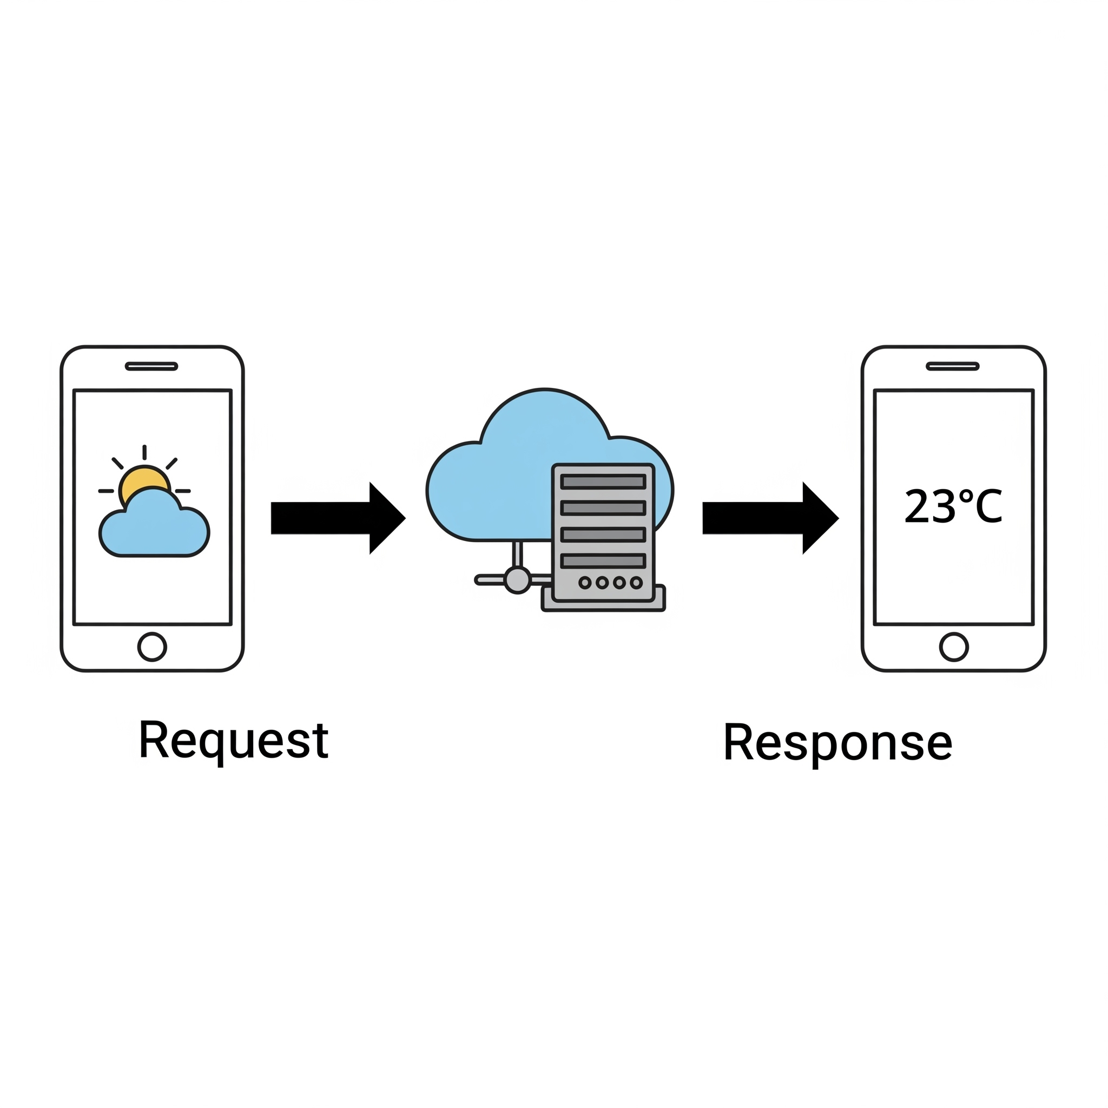
What is a Web Service?
Example:
A weather app on your phone (the client) requests data from a service hosted by a meteorological company. The service sends back the weather information in a standard format.

Slide 6
Types of Web Services (SOAP vs. REST)
SOAP (Simple Object Access Protocol)
Definition:
A formal, standards-based protocol with a strict set of rules for structuring messages.
Explanation:
Relies exclusively on XML for message format.
Operates over protocols like HTTP and SMTP.
Known for high security and reliability.
Includes features for transaction management and error handling.
Best suited for enterprise-level operations.

Slide 7
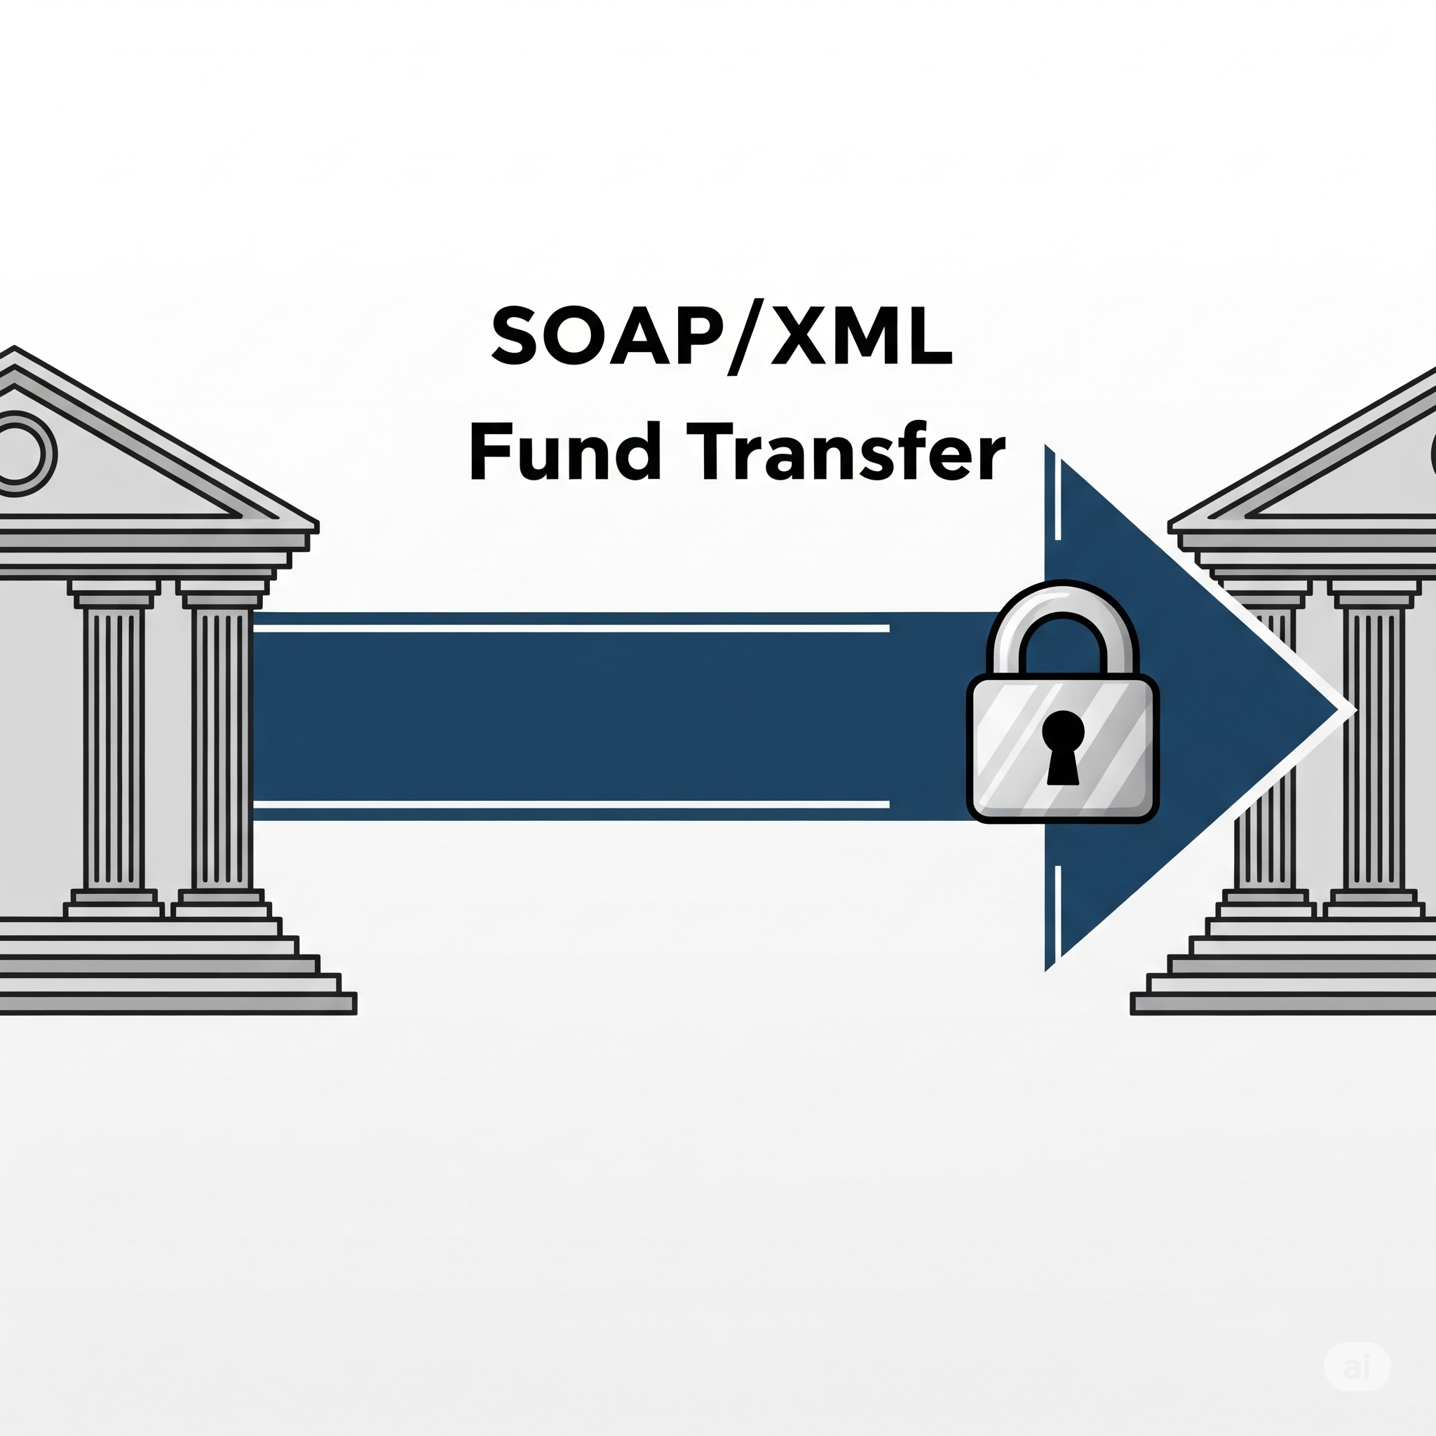
Types of Web Services (SOAP vs. REST)
Example:
A banking application uses a SOAP service to transfer funds, requiring high security and guaranteed delivery.

Slide 8
Types of Web Services (SOAP vs. REST)
2. REST (Representational State Transfer)
Definition:
An architectural style with flexible guidelines for creating scalable and stateless web services.
Explanation:
Uses standard HTTP methods (GET, POST, PUT, DELETE).
Operates on "resources" (data entities).
Can use various data formats, but JSON is most common.
Generally faster and easier to implement than SOAP.

Slide 9
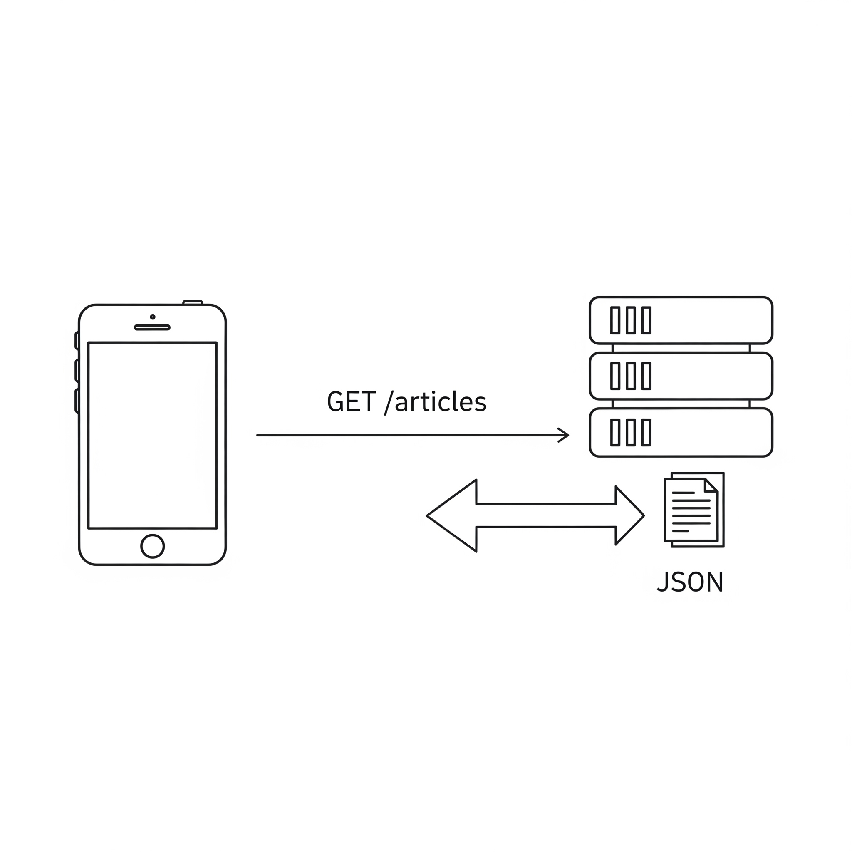
Types of Web Services (SOAP vs. REST)
Example:
A blog's mobile app sends a GET request to/api/articles to fetch a list of recent articles, which are returned as a JSONobject.

Slide 10
Web Services Advantages
Interoperability :
Definition:
The ability of different software systems to communicate and exchange data.
Explanation:
Uses open standards like HTTP and XML/JSON.
Not tied to a single technology (like Java or .NET).

Slide 11
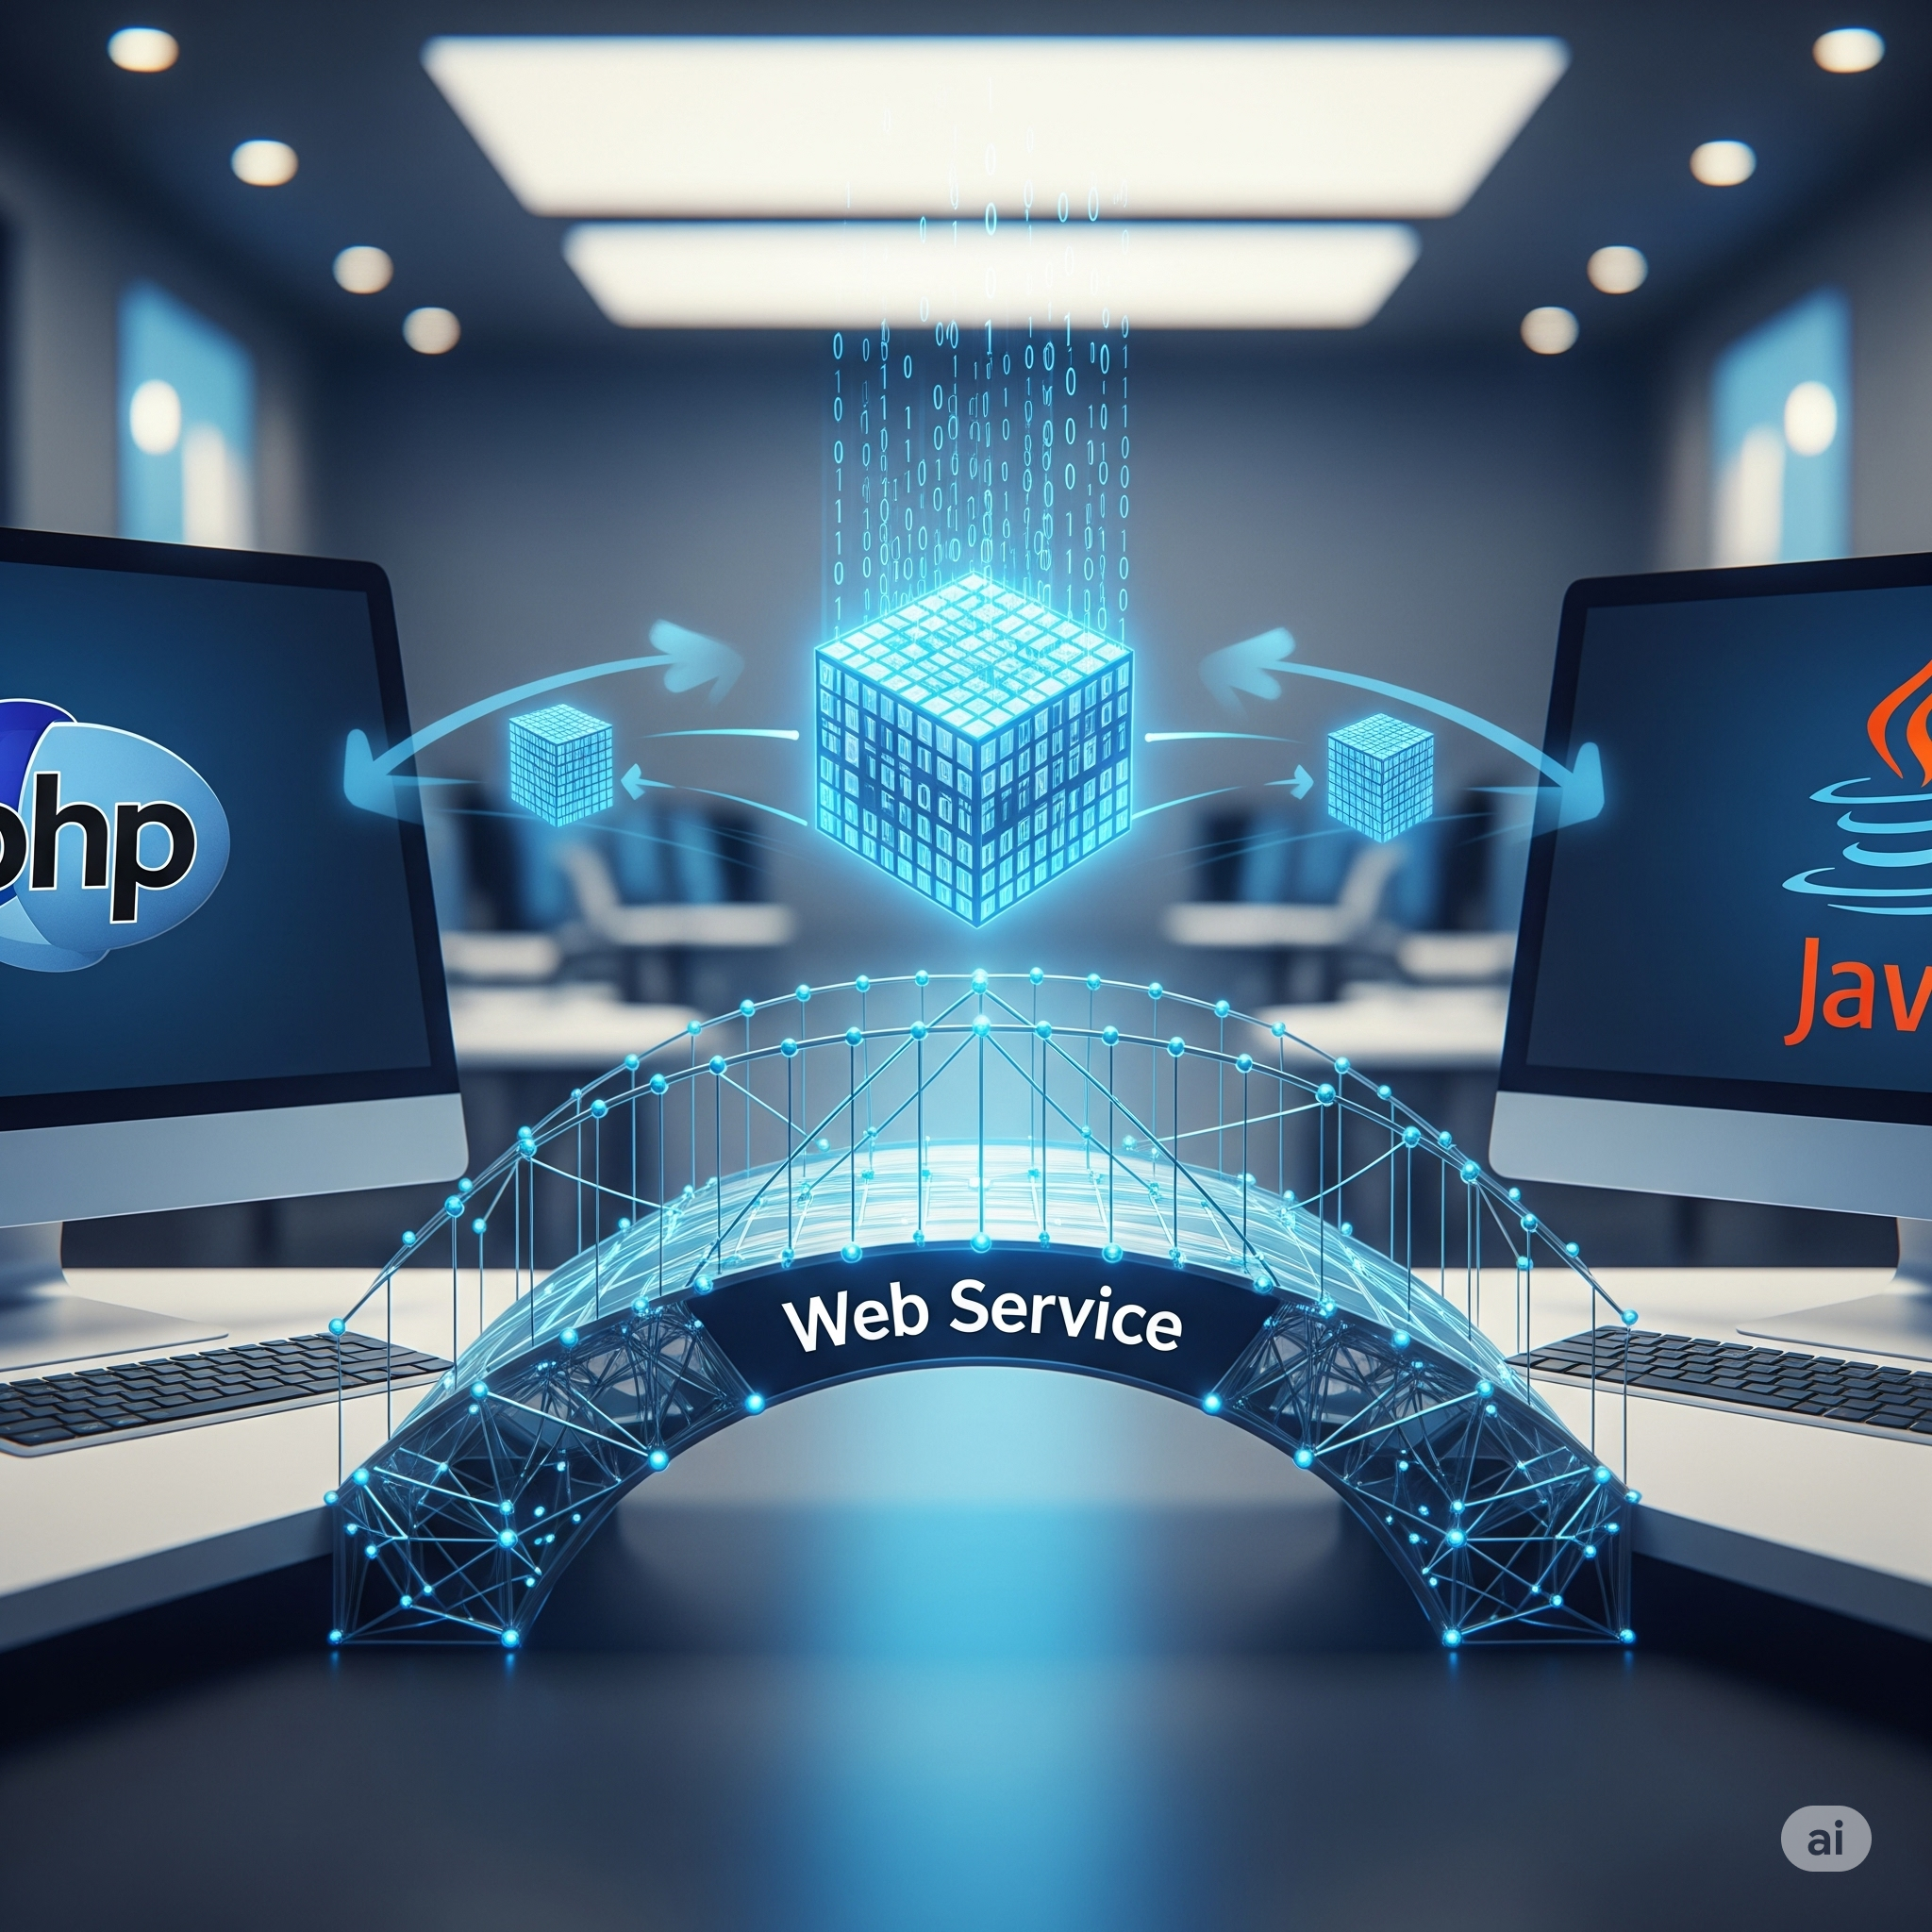
Web Services Advantages
Example:
An e-commerce site (in PHP) calls a shipping provider's service (in Java) to calculate costs.

Slide 12
Web Services Advantages
Reusability :
Definition:
A single web service can be created once and used by many different applications.
Explanation:
Avoids rebuilding the same functionality for every app.
Companies can build one robust service (e.g., for payments) for all products to use.

Slide 13
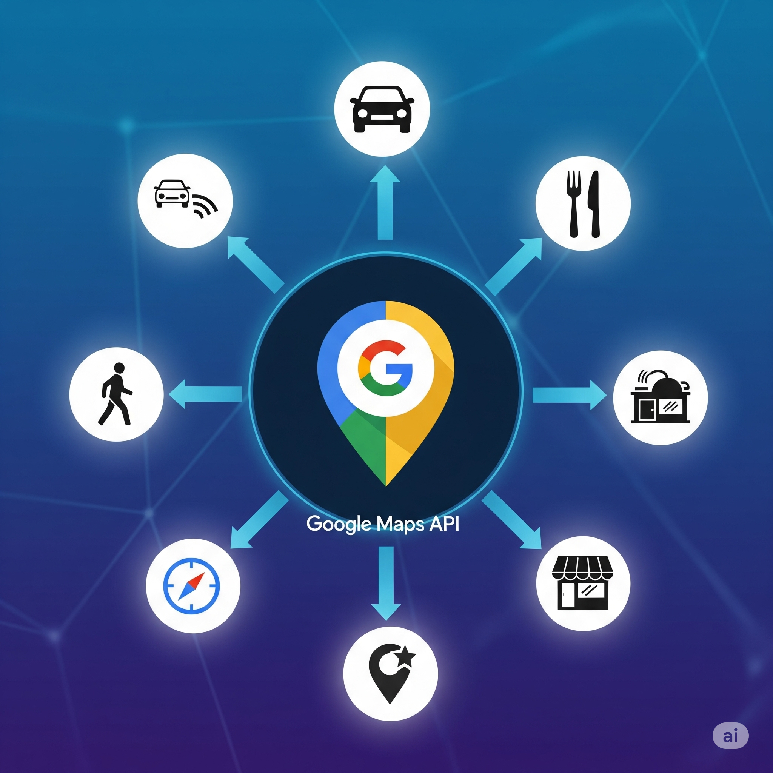
Web Services Advantages
Example:
Thousands of different apps use the single Google Maps API to display maps.

Slide 14
Web Services Advantages
Loose Coupling :
Definition:
The client and server are not tightly dependent on each other's internal code.
Explanation:
The API contract is the only link between them.
The provider can change its internal logic without breaking the client application.

Slide 15
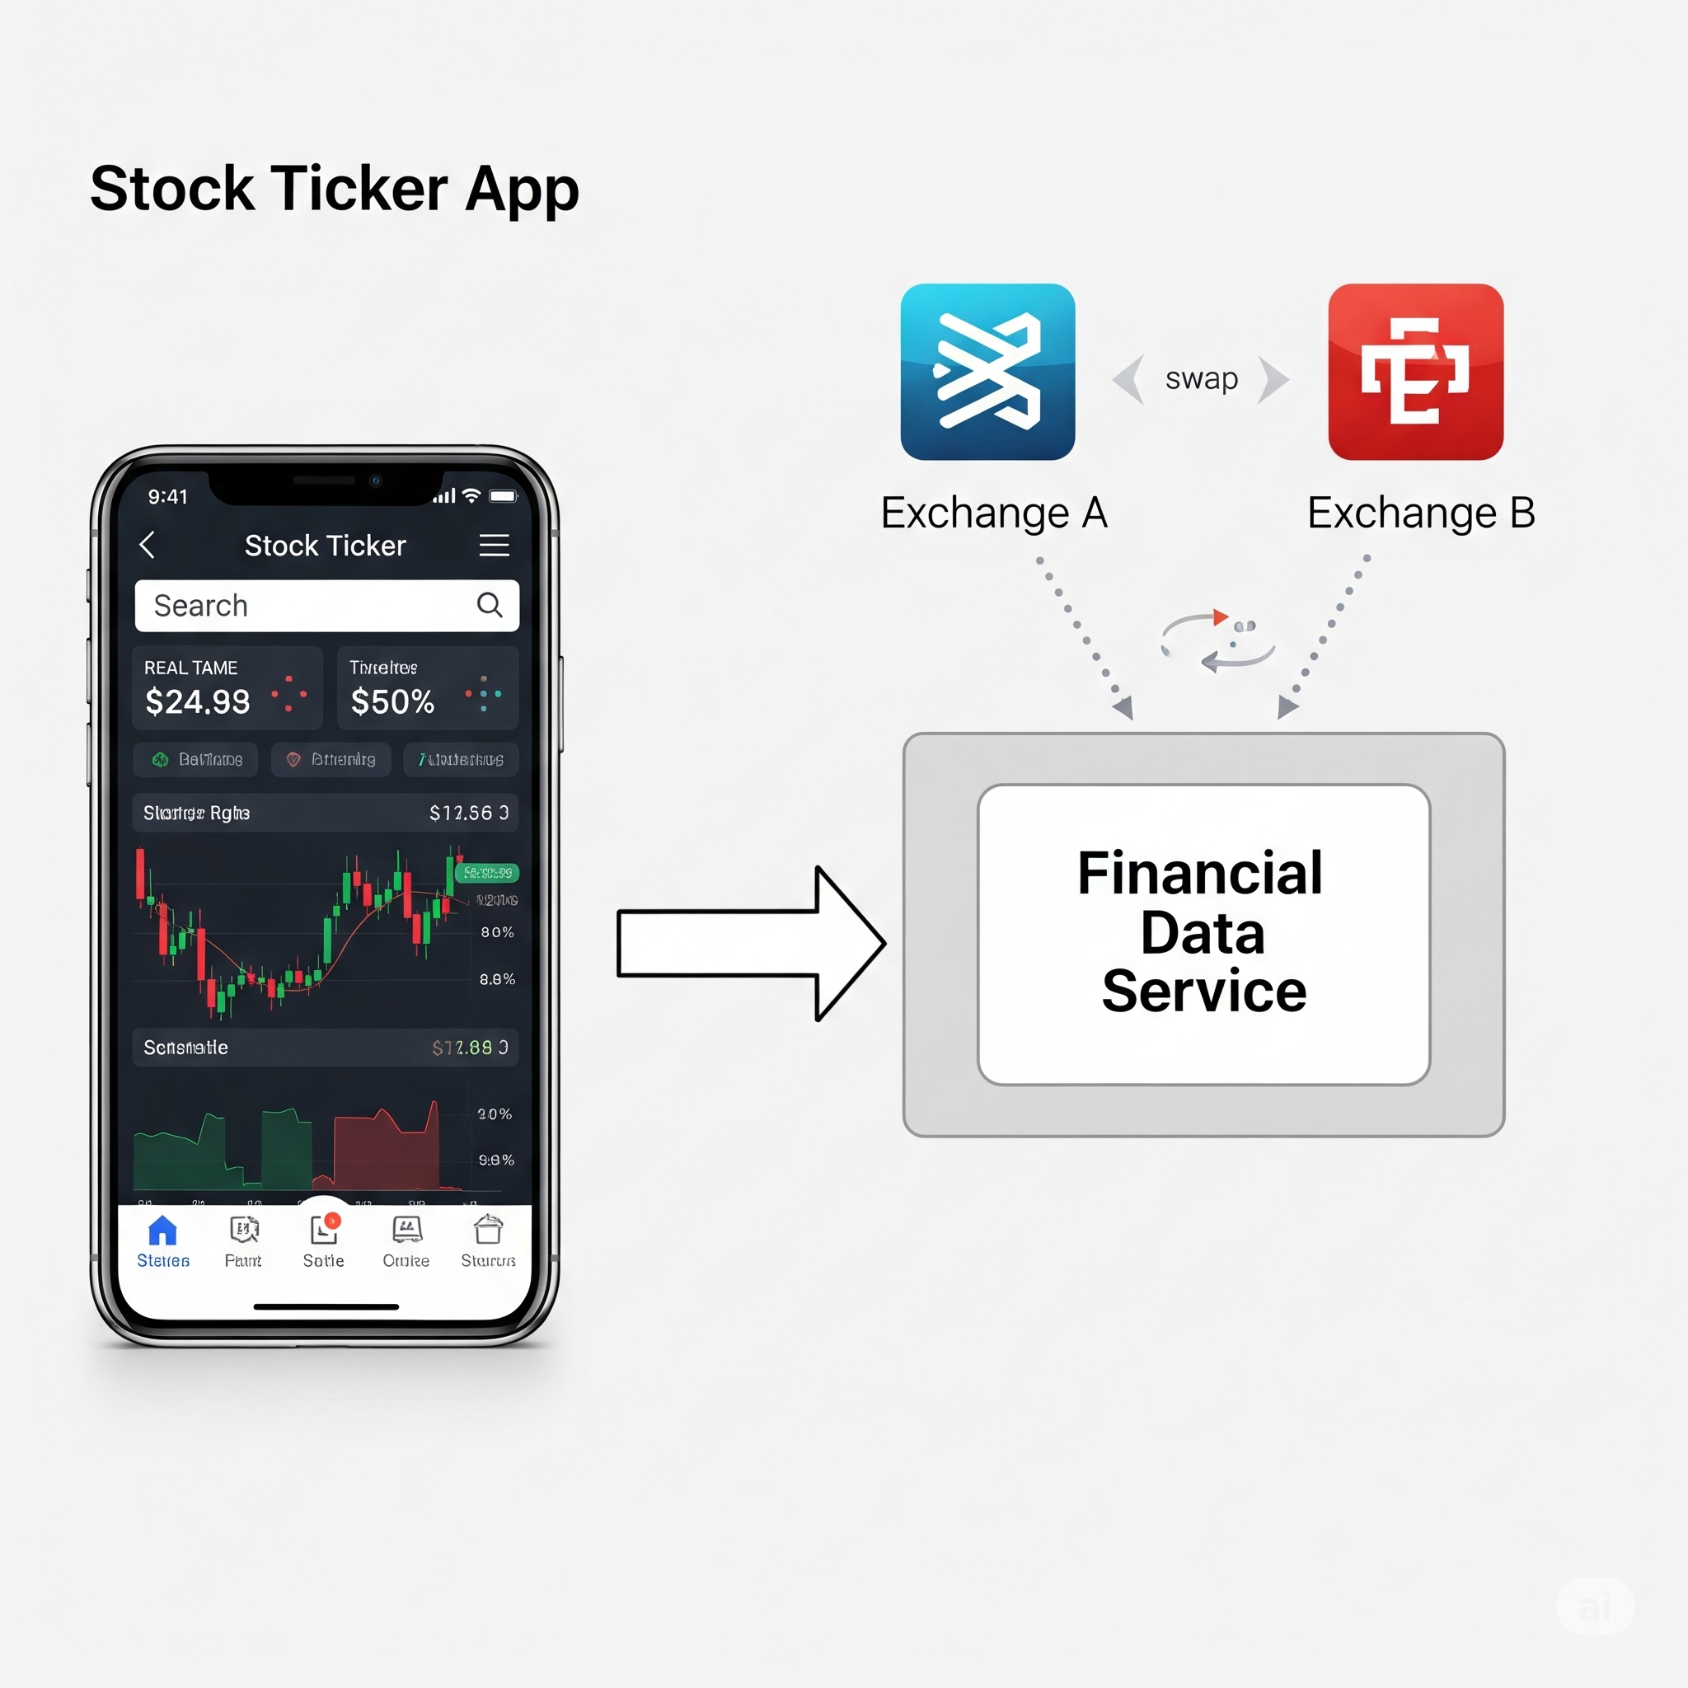
Web Services Advantages
Example:
A stock ticker app gets data from a service. The service provider can change its data source, and the app is unaffected.

Slide 16
Web Service Architecture
Service Provider :
Definition:
The entity that creates, publishes, and hosts the web service.
Explanation:
The "server" side of the interaction.
Owns the business logic and data.
Listens for and responds to requests from clients.

Slide 17
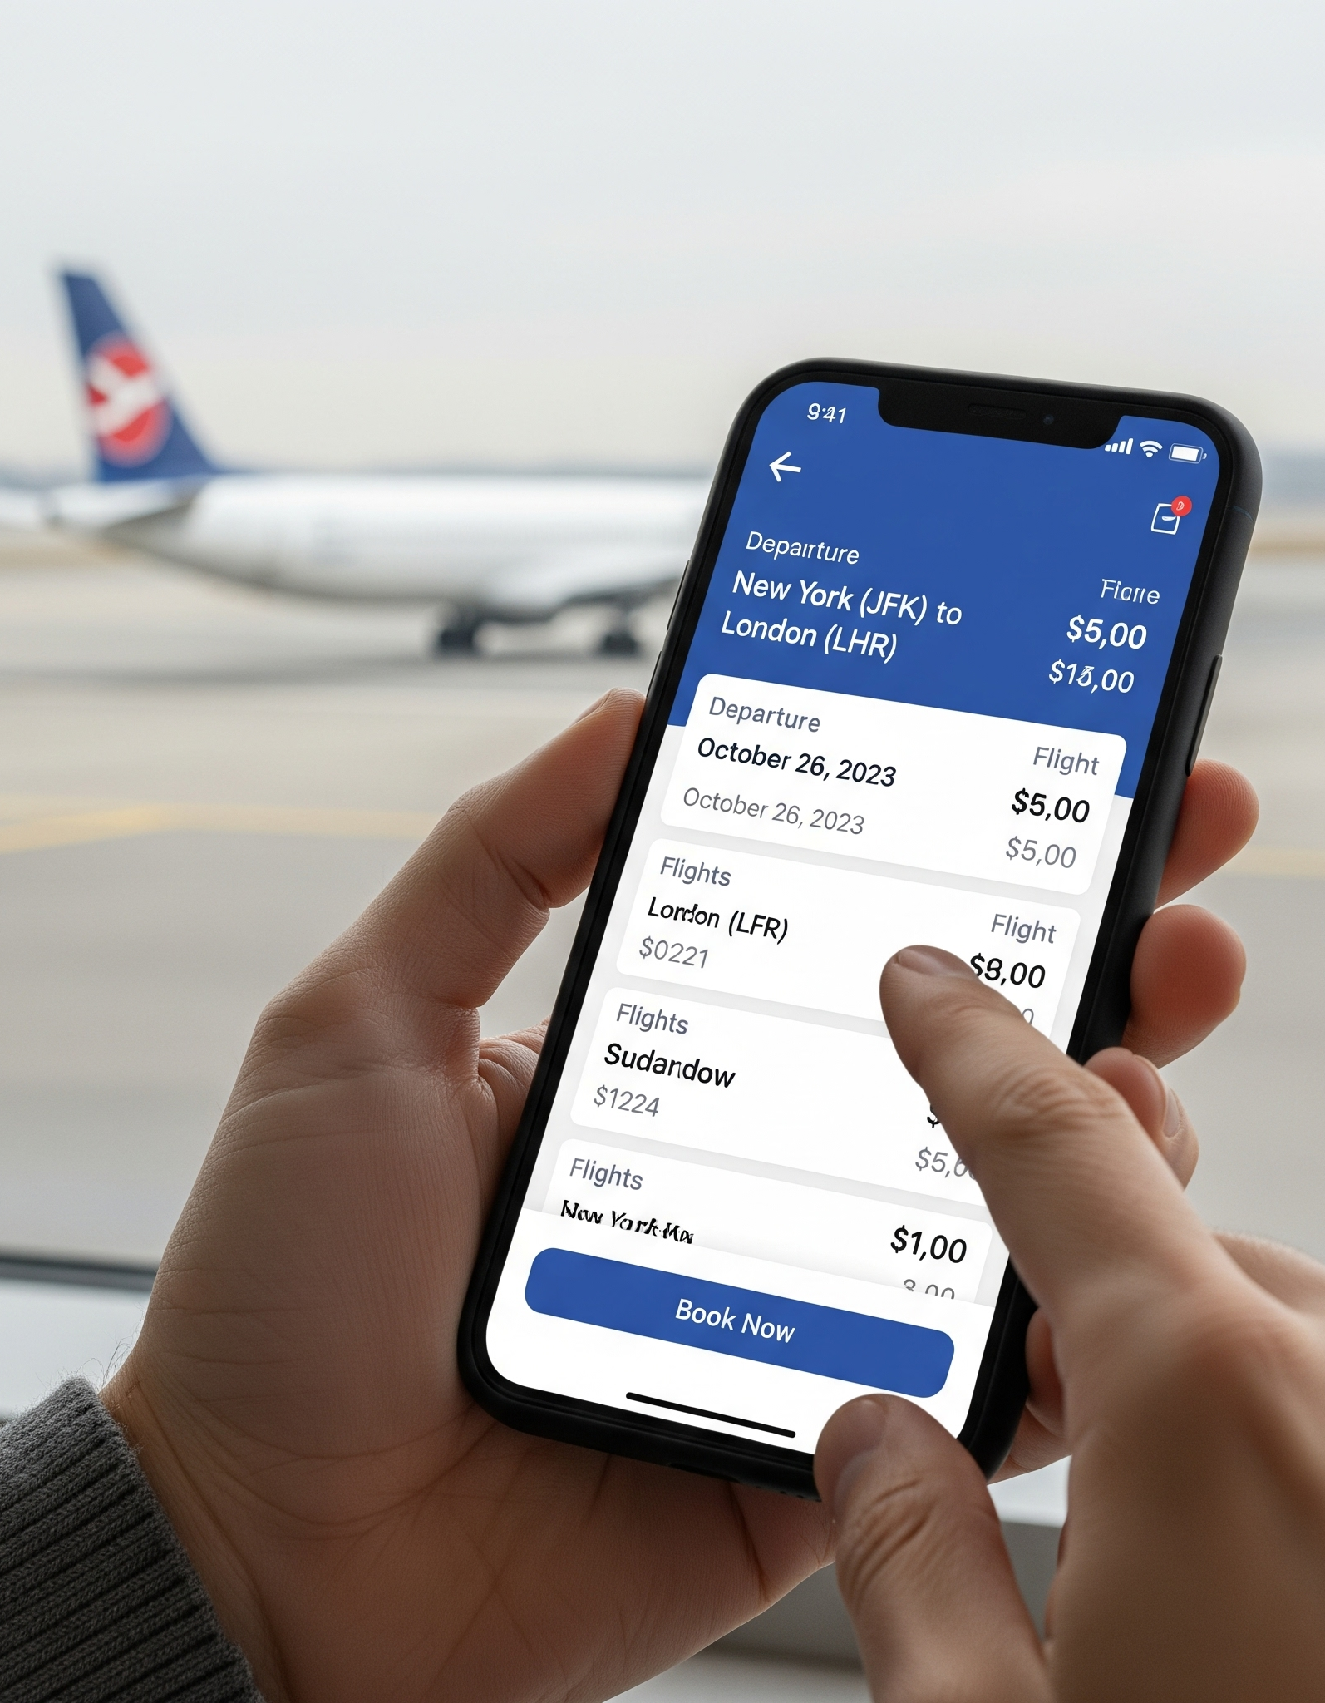
Web Service Architecture
Example:
An airline company that creates a service for booking tickets.

Slide 18
Web Service Architecture
Service Requester (Client) :
Definition:
The application that needs to use a web service to perform a task.
Explanation:
The "client" side that initiates communication.
Finds the service and sends a request.

Slide 19
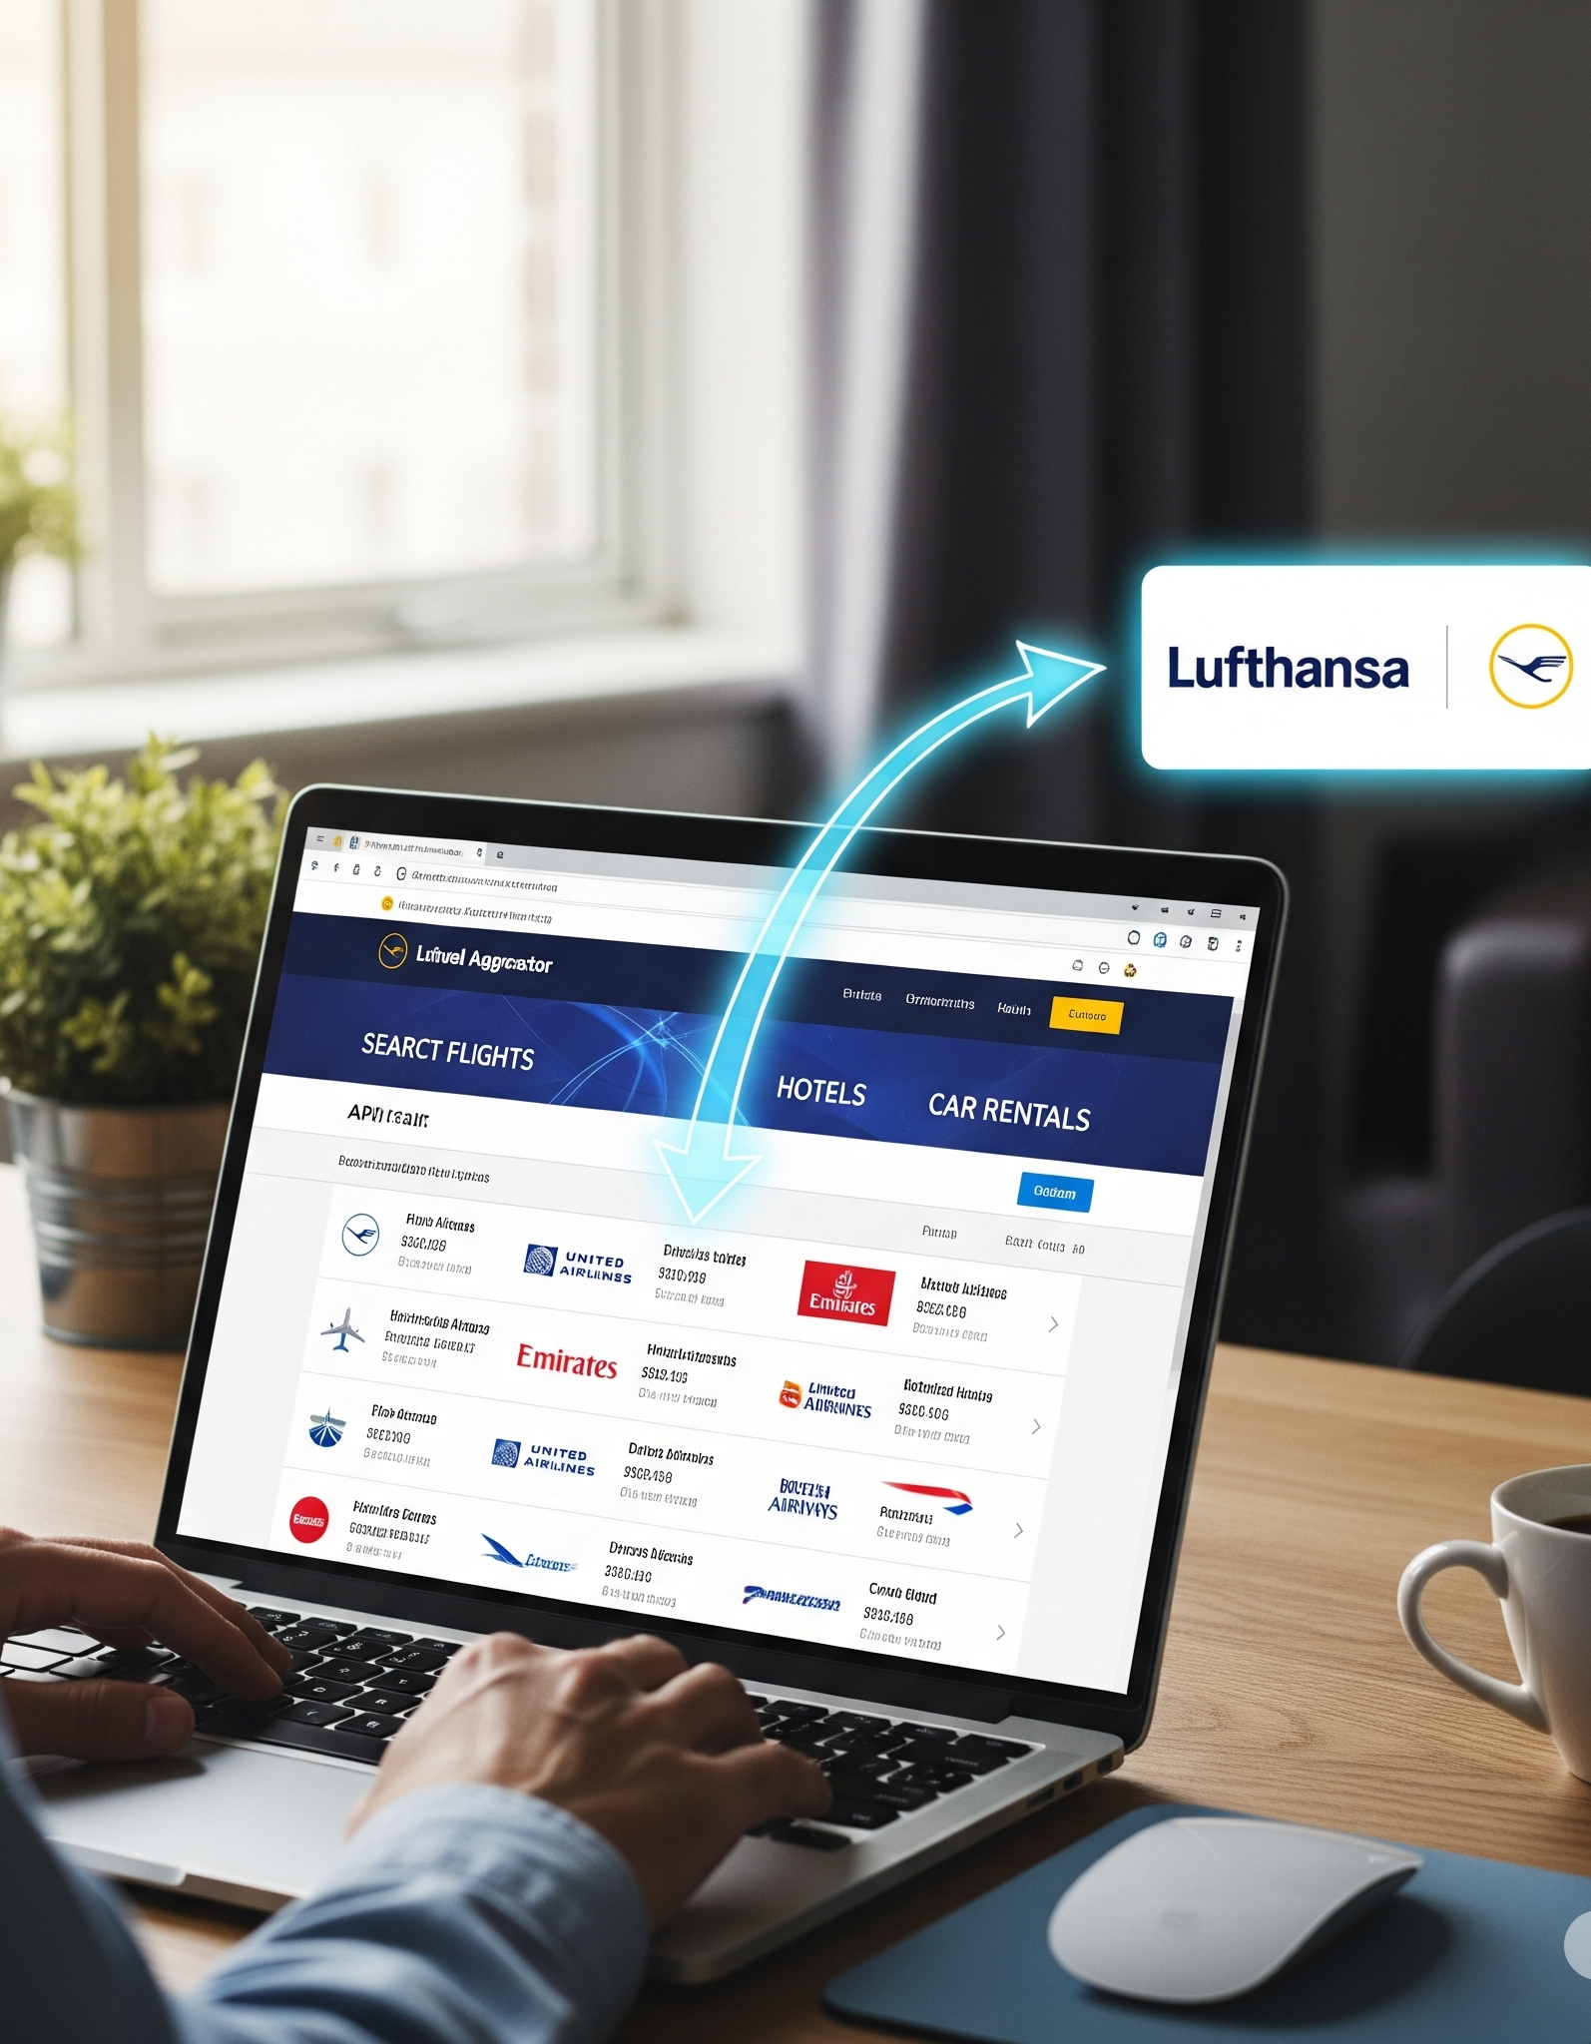
Web Service Architecture
Example:
A travel aggregator website (like Expedia) that calls the airline's service to get flight data.

Slide 20
Web Service Architecture
Service Registry (Broker) :
Definition:
An optional, centralized directory to publish and discover web services.
Explanation:
Acts like a "phone book" for web services.
Provider publishes the service; Requester finds the service.
Less common for public REST APIs today.

Slide 21
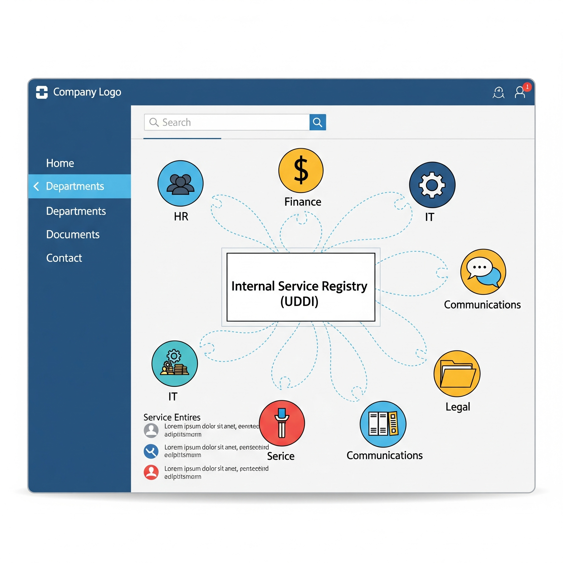
Web Service Architecture
Example:
A large company's internal UDDI registry for sharing services between departments.

Slide 22
Web Service Characteristics
XML-Based :
Definition:
Traditionally uses XML to format data in requests and responses.
Explanation:
XML provides a text-based, platform-neutral way to structure data.
Central to SOAP; modern REST services often prefer the lighter JSON format.
Example:
A SOAP request: <getUser><userId>123</userId></getUser>.

Slide 23
Web Service Characteristics
Platform Independent :
Definition:
Can be accessed by any client, regardless of its operating system or programming language.
Explanation:
Possible because it uses universal web standards (HTTP, XML/JSON).
A server on Windows (C#) can serve a client on a MacBook (Python).
Example:
An iPhone app (written in Swift) calls a web service (written in Java) running on a Linux server.

Slide 24
Conclusion
Web services are fundamental for modern application integration.
They enable systems to communicate and share data over the web.
Key benefits: interoperability, reusability, and standardization.
Architecture involves a provider, a requester, and an optional registry.
Essential knowledge for building distributed, scalable applications.

Slide 25
Thank You !!

